Slide 1
From Unstructured Text to TextCube: Automated Construction and Multidimensional Exploration
Jiawei Han
Computer Science
University of Illinois at Urbana-Champaign
May 13, 2025

Slide 2
Outline
On the Power of Multi-Dimensional Text Cubes
Automated Mining of Semantic Structures from Massive Text Data
Phrase Mining
Entity/Relation Recognition and Typing
Meta Pattern-Directed Structure Discovery
Automated Construction of Multidimensional Text Cubes
Multifaceted Taxonomy Mining
Doc2Cube: Constructing TextCube from Massive Documents
Quality Enhancement: Local and Global Joint Spherical Text Embedding
Looking Forward

Slide 3
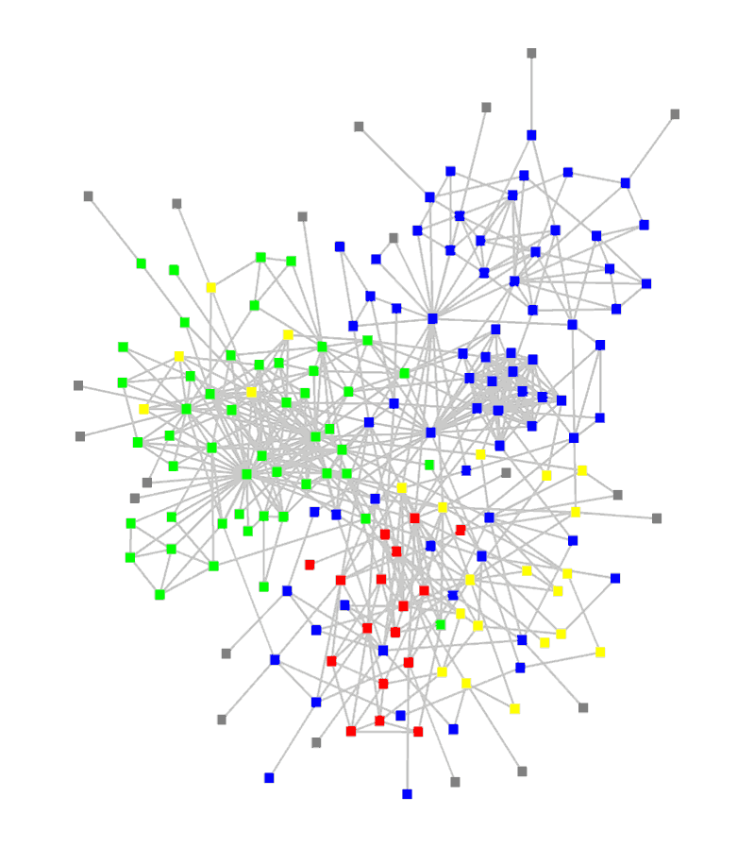
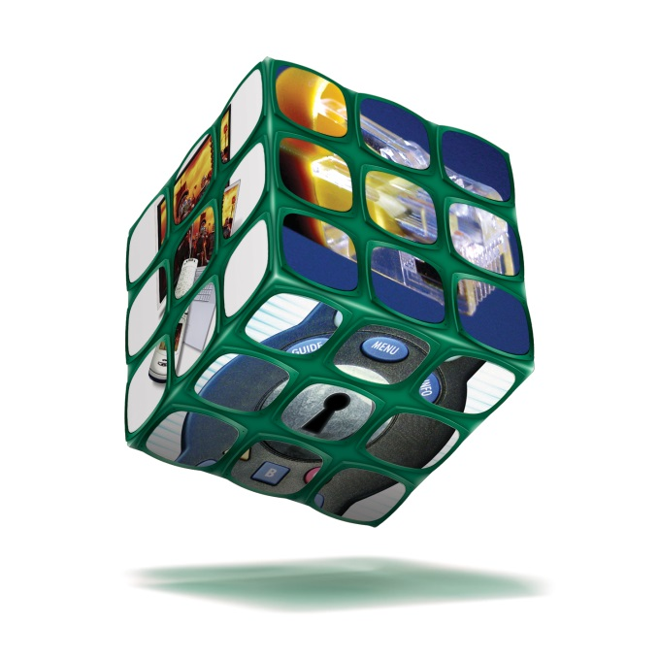
From Big Data to Big Knowledge: Taming Text is the Key
Ubiquity of big unstructured data
Big Data: Over 80% of our data is from text/natural language/social media, unstructured/semi-structured, noisy, dynamic, …, but inter-related!
How to mine such big data systematically?
Structuring (i.e., transforming unstructured text into structured, typed, interconnected entities/relationships)
Networking (take advantage of massive, structured connections)
Mining massive structures and networks
Our roadmap:
Mining hidden structures from text data
Turning text data into multidimensional text-cubes and typed networks
Mining cubes and networks to generate actionable knowledge

Slide 4
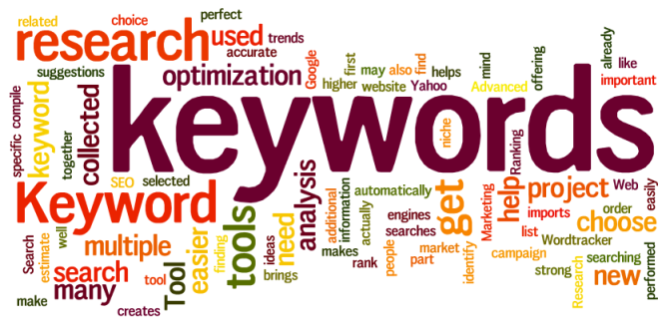
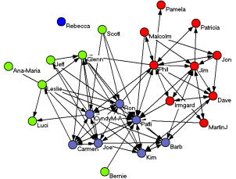








Bottleneck: Mining Unstructured Text for Structures
One of the most challenging issues at mining big data: structuring and mining text!!
Bottleneck: How to automatically generate structures from text data?
Automated mining of phrases, topics, entities, links and types from text corpora
Heterog. networks
Text Corpus
Phrases
Knowledge
General KB
Typed entities
Multi-dimensional Cubes

Slide 5

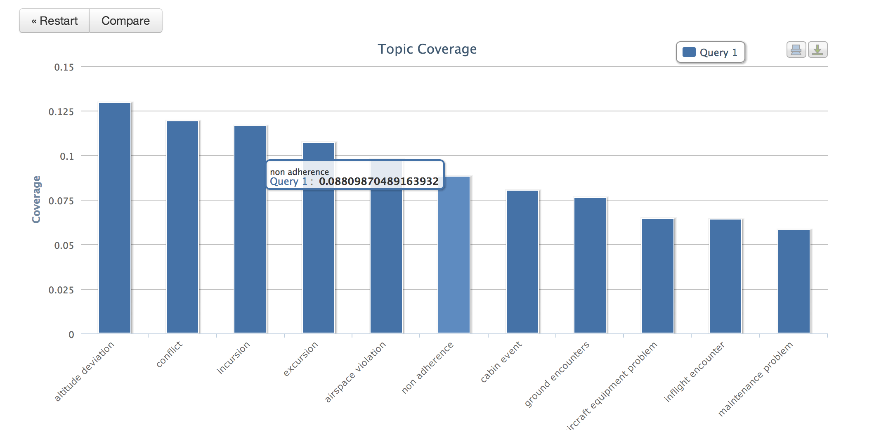
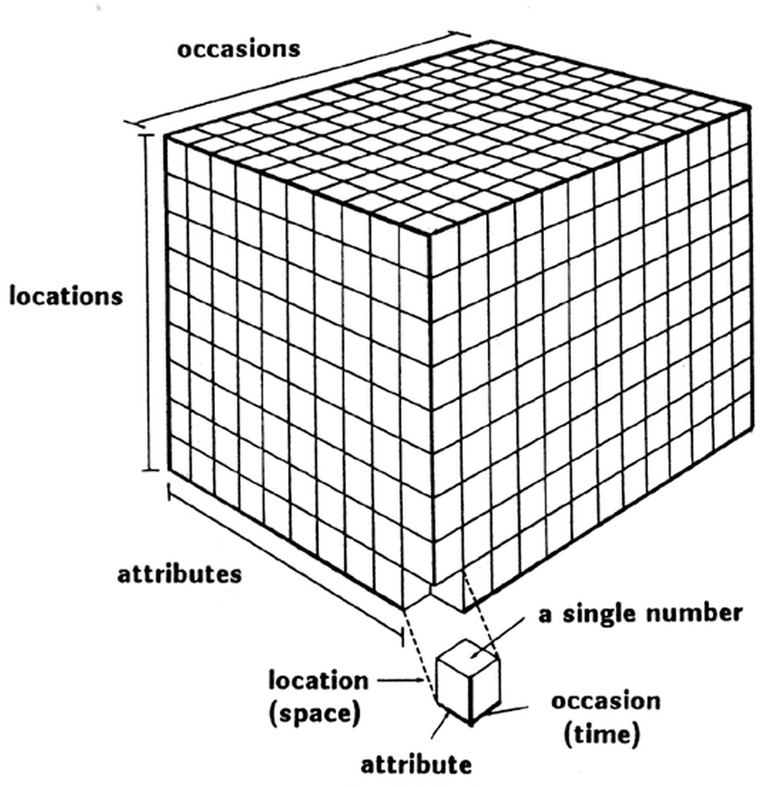
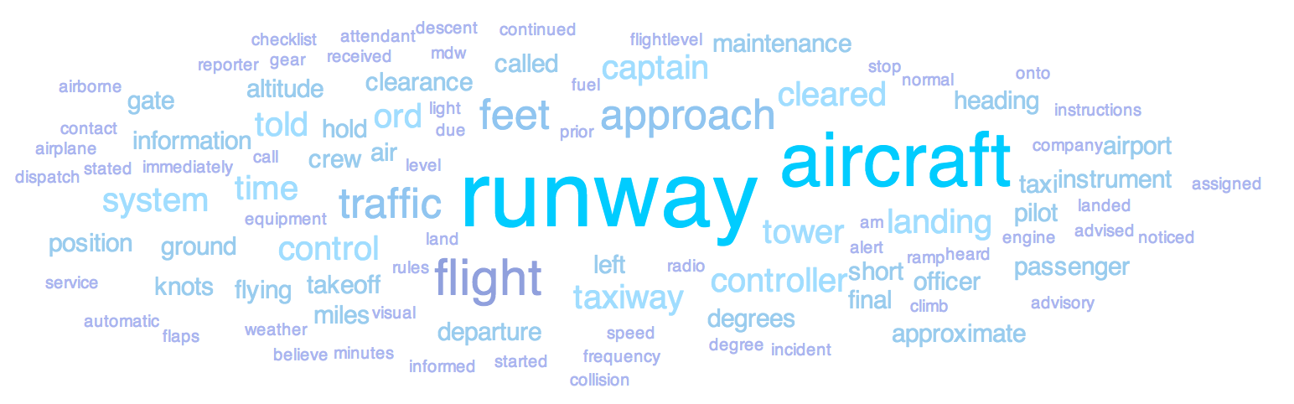
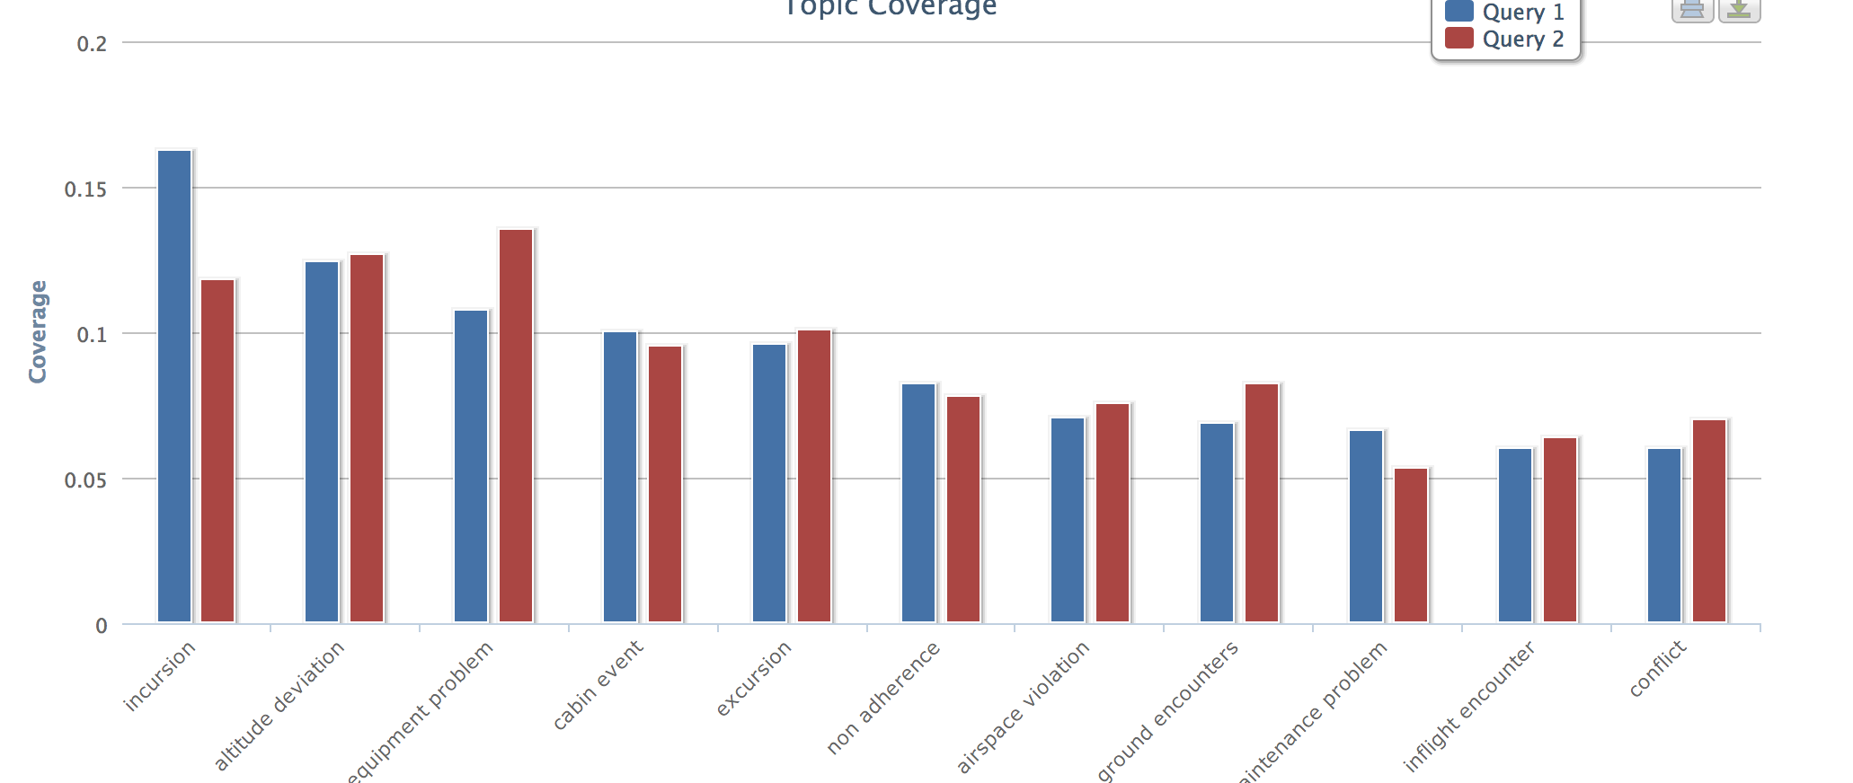
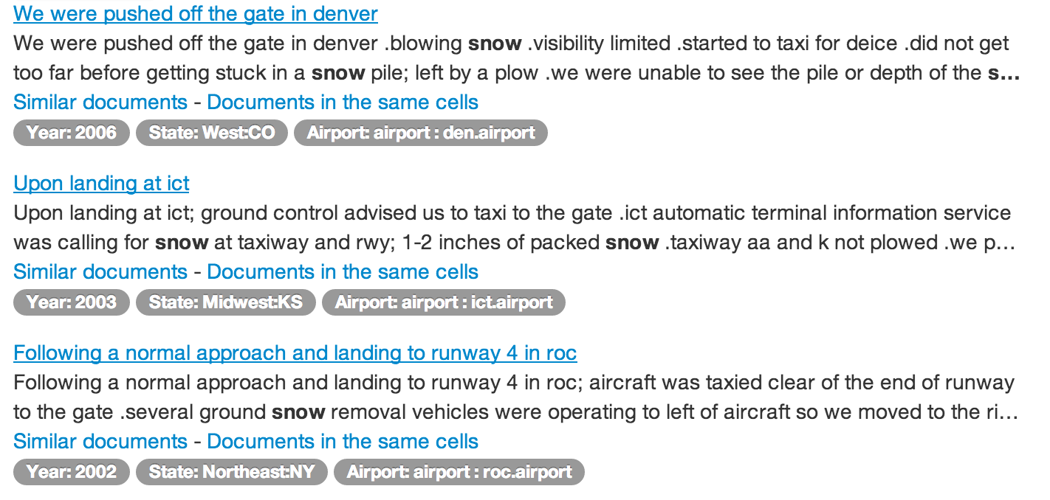
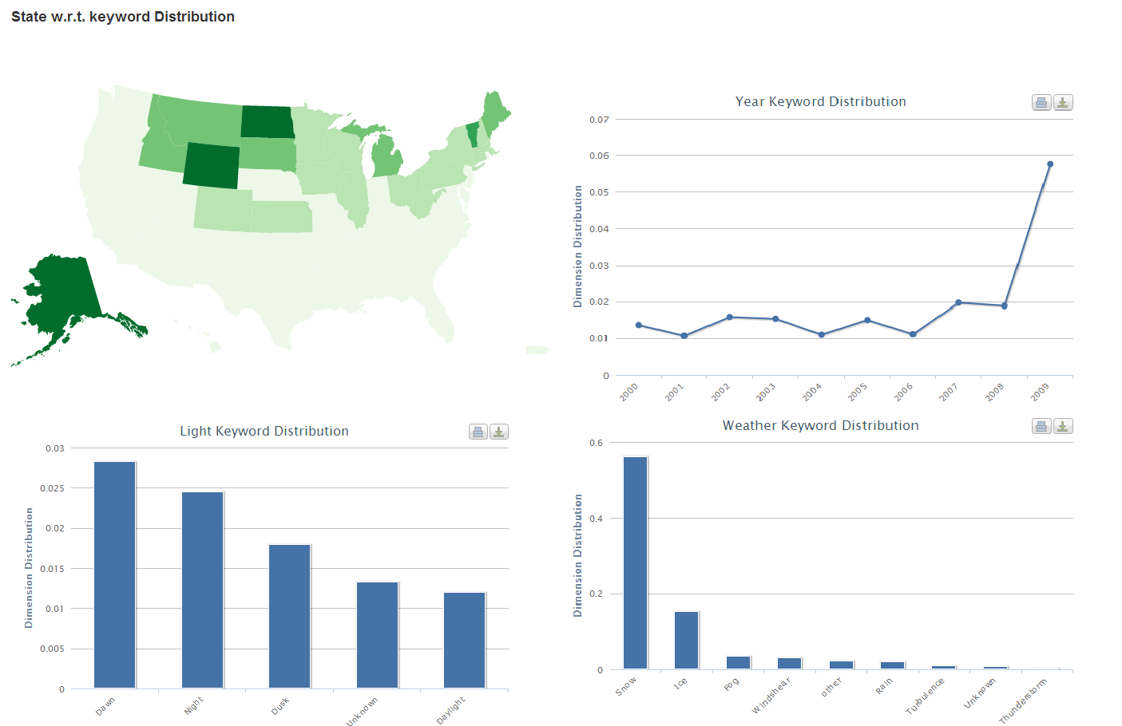
The Power of Text Cube: Multi-Dimensional Text Analysis
From TextCube to EventCube [KDD’13 demo]
Keyword- or entity-based search or summary of documents
CASeOLAP [EngBul’16]: Comparative summary/mining
Rio
London
Beijing
Soccer
Basketball
Volleyball
Slice
Roll-up
Drill-down
Dice
…
Cube Structure
Textual Analysis
Text Data
Structural Analysis

Slide 6
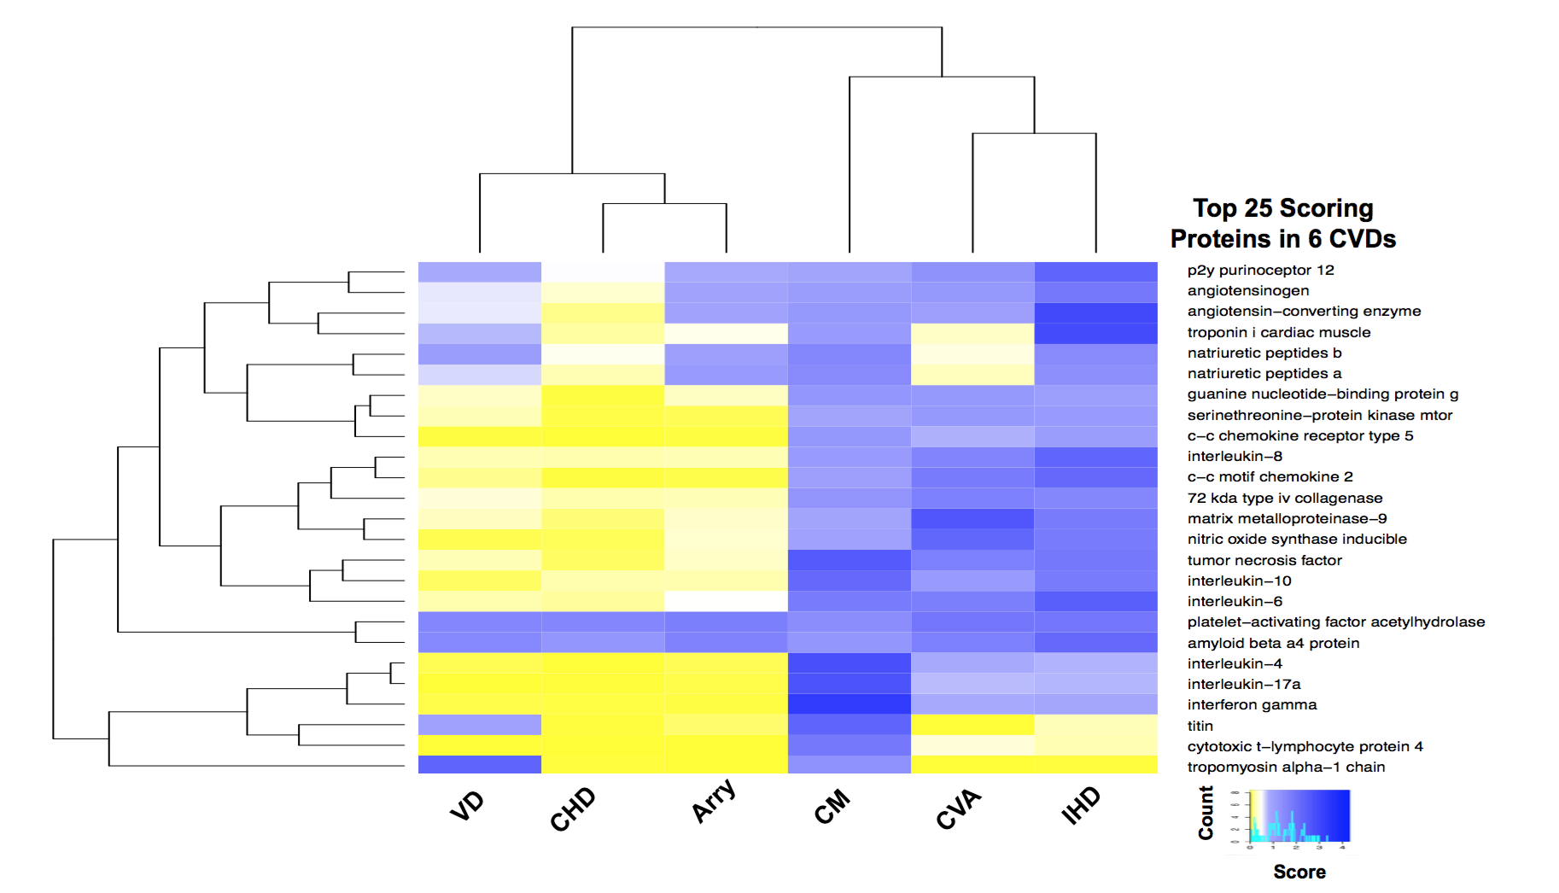
Effectiveness of Comparative Summary on Real-World Cases
Contrasting analysis
Integrity
Popularity
distinctness
Mining distinct phrases: 2016 news data
Mining Distinct relationships between 6 subcategories of cardiovascular diseases and proteins: PubMed Abstracts

Slide 7
Outline
On the Power of Multi-Dimensional Text Cubes
Automated Mining of Semantic Structures from Massive Text Data
Phrase Mining
Entity/Relation Recognition and Typing
Meta Pattern-Directed Structure Discovery
Automated Construction of Multidimensional Text Cubes
Multifaceted Taxonomy Mining
Doc2Cube: Constructing TextCube from Massive Documents
Quality Enhancement: Local and Global Joint Spherical Text Embedding
Looking Forward

Slide 8
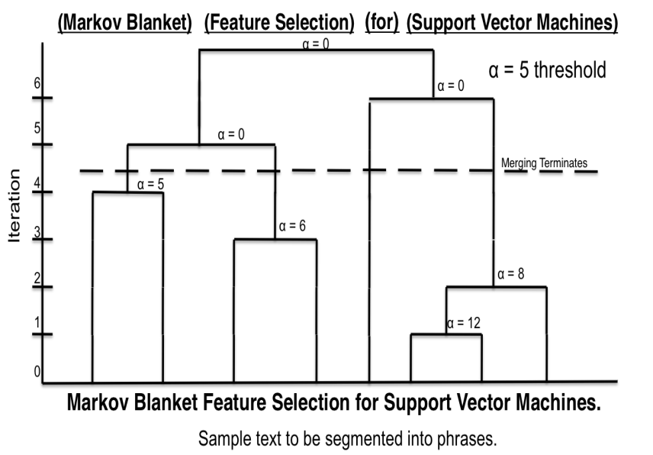
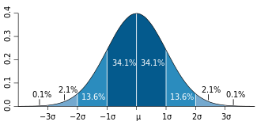
TopMine: Frequent Pattern Mining + Statistical Analysis
First perform frequent contiguous pattern mining to extract candidate phrases and their counts
Quality phrases
Based on significance score [Church et al.’91]:
α(P₁, P₂) ≈ (f(P₁●P₂) ̶ µ₀(P₁,P₂))/√ f(P₁●P₂)
[Markov blanket] [feature selection] for [support vector machines]
[knowledge discovery] using [least squares] [support vector machine] [classifiers]
…[support vector] for [machine learning]…
Phrase | Raw freq. | True freq.
[support vector machine] | 90 | 80
[vector machine] | 95 | 0
[support vector] | 100 | 20

Slide 9
AutoPhrase: Automated Phrase Mining
ToPMing (unsupervised) [VLDB’14] → SegPhrase (weakly supervised) [SIGMOD’15] → AutoPhrase (distantly supervised) [TKDE’18]
Automatic extraction of high-quality phrases (e.g., scientific terms and general entity names) in a given corpus (e.g., research papers and news)
No human efforts / Multiple languages / High performance—precision, recall, efficiency

Slide 10
Experiments and Performance Comparison
Datasets:
Phrase Mining Results
Comparing methods
SegPhrase/WrapSegPhrase (encoding preprocessing for handling non-English)
TF-IDF/TextRank

Slide 11
Outline
On the Power of Multi-Dimensional Text Cubes
Automated Mining of Semantic Structures from Massive Text Data
Phrase Mining
Entity/Relation Recognition and Typing
Meta Pattern-Directed Structure Discovery
Automated Construction of Multidimensional Text Cubes
Multifaceted Taxonomy Mining
Doc2Cube: Constructing TextCube from Massive Documents
Quality Enhancement: Local and Global Joint Spherical Text Embedding
Looking Forward

Slide 12
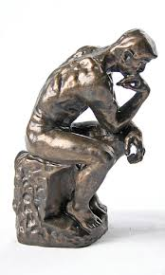



Recognizing Typed Entities
Identifying token span as entity mentions in documents and labeling their types
— Enabling structured analysis of unstructured text corpus
FOOD
LOCATION
JOB_TITLE
EVENT
ORGANIZATION
…
The best BBQ I’ve tasted in Phoenix! I had the pulled pork sandwich with coleslaw and baked beans for lunch. ... The owner is very nice. …
The best BBQ:Food I’ve tasted in Phoenix:LOC ! I had the [pulled pork sandwich]:Food with coleslaw:Food and [baked beans]:Food for lunch. … The owner:JOB_TITLE is very nice. …
Target Types
Plain text
Text with typed entities
Traditional methods:
Expensive human labor on annotation of 500 documents for entity extraction and 20,000 queries for entity linking
FOOD
LOCATION
EVENT
Can we use the “distant labels” in the KBs?
Social media challenge!

Slide 13
The ClusType Framework: Phrase Segmentation and Heterogeneous Graph Construction [KDD’15]
POS-constrained phrase segmentation for mining candidate entity mentions and relation phrases, simultaneously
Construct a heterogeneous graph to represent available information in a unified form
Entity mentions are kept as individual objects to be disambiguated
Linked to entity surface names & relation phrases
Weight assignment: The more two objects are likely to share the same label, the larger the weight will be associated with their connecting edge

Slide 14
The Framework: Mutual Enhancement of Type Propagation and Relation Phrase Clustering
With the constructed graph, formulate a graph-based semi-supervised learning of two tasks jointly:
Derived entity argument types serve as good feature for clustering relation phrases
Type propagation on heterogeneous graph
Propagate type information among entities bridges via synonymous relation phrases
Multi-view relation phrase clustering
Mutually enhancing each other; leads to quality recognition of unlinkable entity mentions

Slide 15
ClusType: Comparing with State-of-the-Art Systems
Methods | NYT | Yelp | Tweet
Pattern (Stanford, CONLL’14) | 0.301 | 0.199 | 0.223
SemTagger (U Utah, ACL’10) | 0.407 | 0.296 | 0.236
NNPLB (UW, EMNLP’12) | 0.637 | 0.511 | 0.246
APOLLO (THU, CIKM’12) | 0.795 | 0.283 | 0.188
FIGER (UW, AAAI’12) | 0.881 | 0.198 | 0.308
ClusType (KDD’15) | 0.939 | 0.808 | 0.451
Bootstrapping
Label propagation
F1-score
Classifier with
linguistic features
vs. bootstrapping: context-aware prediction on “un-matchable”
vs. label propagation: group similar relation phrases
vs. FIGER: no reliance on complex feature engineering
NYT: 118k news articles (1k manually labeled for evaluation); Yelp: 230k business reviews (2.5k reviews are manually labeled for evaluation); Tweet: 302 tweets (3k tweets are manually labeled for evaluation)
Precision (P) = $\frac{\#Correctly−typed mentions }{\#System−recognized mentions}$ , Recall (R) = $\frac{\#Correctly−typed mentions }{\#ground−truth mentions}$, F1 score = $\frac{2\left(P×R\right)}{(P+R) }$

Slide 16
Outline
On the Power of Multi-Dimensional Text Cubes
Automated Mining of Semantic Structures from Massive Text Data
Phrase Mining
Entity/Relation Recognition and Typing
Meta Pattern-Directed Structure Discovery
Automated Construction of Multidimensional Text Cubes
Multifaceted Taxonomy Mining
Local and Global Joint Spherical Text Embedding
Looking Forward

Slide 17
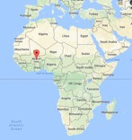
MetaPAD: Meta Pattern-driven Attribute Discovery from Massive Text Corpora [KDD’17]
Given a sentence in a large corpus, “President Blaise Compaoré’s government of Burkina Faso was founded…”, …
Can we find:
Blaise Compaoré: $PERSON.POLITICIAN
age:65
Burkina Faso: $COUNTRY
president
population: 17 million
Attribute Discovery: Two tasks
Task 1: ⟨entity, attribute name, attribute value⟩
⟨Burkina Faso, president, Blaise Compaoré⟩
⟨Burkina Faso, population, 17 million⟩
⟨Blaise Compaoré, age, 65⟩
Task 2: ⟨entity type, attribute name⟩
⟨$COUNTRY, president⟩
⟨$COUNTRY, population⟩
⟨$PERSON, age⟩
Instance-level
Type-level

Slide 18
The Meta-Pattern Methodology
(#1) “President Blaise Compaoré’s government of Burkina Faso was founded …”
(#2) “President Barack Obama’s government of U.S. claimed that…”
(#3) “U.S. President Barack Obama visited …”
Generate patterns with massive instances in the data
No heavy annotation required
No domain knowledge required
No query log required
if we can recognize and type the entities in the same manner…
Meta pattern segmentation
Meta patterns:
⎡president $PERSON.POLITICIAN ’s government of $LOCATION.COUNTRY⎦ was founded…
⎡$LOCATION.COUNTRY president $PERSON.POLITICIAN⎦ …
⟨$COUNTRY, {president}, $POLITICIAN⟩
Adjust types for appropriate granularity
Generate massive triples by matching the meta patterns
Group synonymous patterns by massive triples
Joint extraction
⟨Burkina Faso, {president}, Blaise Compaoré⟩
⟨U.S., {president}, Barack Obama⟩

Slide 19
Patterns, Entities and Attribute Values Found in News Corpus
Meta patterns | Entity | Attribute value
$COUNTRY President $POLITICIAN $COUNTRY’s president $POLITICIAN President $POLITICIAN of $COUNTRY … $POLITICIAN’s government of $COUNTRY | United States | Barack Obama
 | Russia | Vladimir Putin
 | France | Francois Hollande
 | … | …
 | Burkina Faso | Blaise Compaoré
Meta patterns | Entity | Attribute value
$COMPANY CEO $PERSON $COMPANY chief executive $PERSON $PERSON, the $COMPANY CEO, … $COMPANY former CEO $PERSON $PERSON, the $COMPANY former CEO, | Apple | Tim Cook
 | Facebook | Mark Zuckerberg
 | Hewlett-Packard | Carly Fiorina
 | … | …
 | Infor | Charles Phillips
 | Afghan Citadel | Roya Mahboob

Slide 20
Outline
On the Power of Multi-Dimensional Text Cubes
Automated Mining of Semantic Structures from Massive Text Data
Phrase Mining
Entity/Relation Recognition and Typing
Meta Pattern-Directed Structure Discovery
Automated Construction of Multidimensional Text Cubes
Multifaceted Taxonomy Mining
Doc2Cube: Constructing TextCube from Massive Documents
Quality Enhancement: Local and Global Joint Spherical Text Embedding
Looking Forward

Slide 21

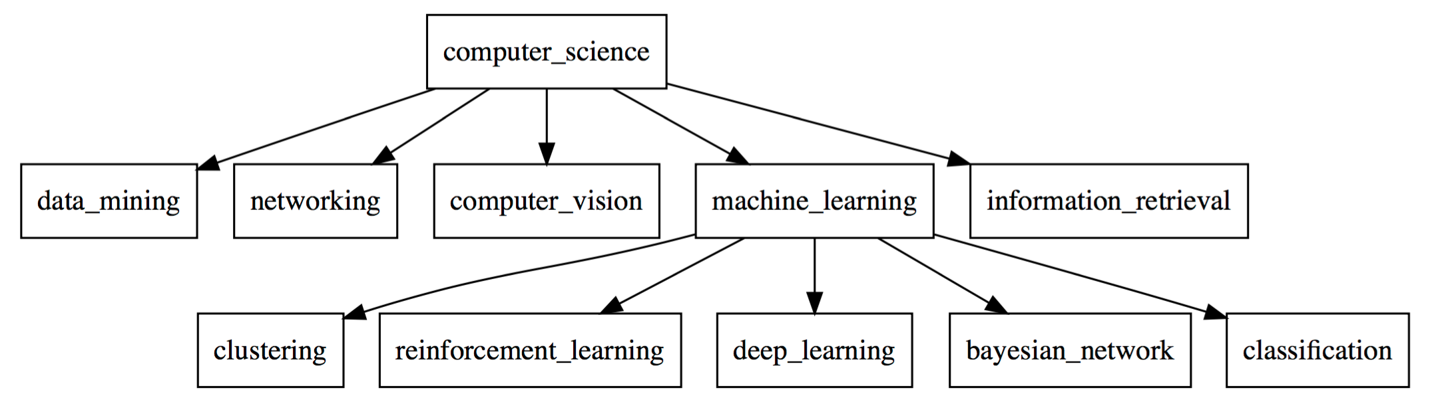
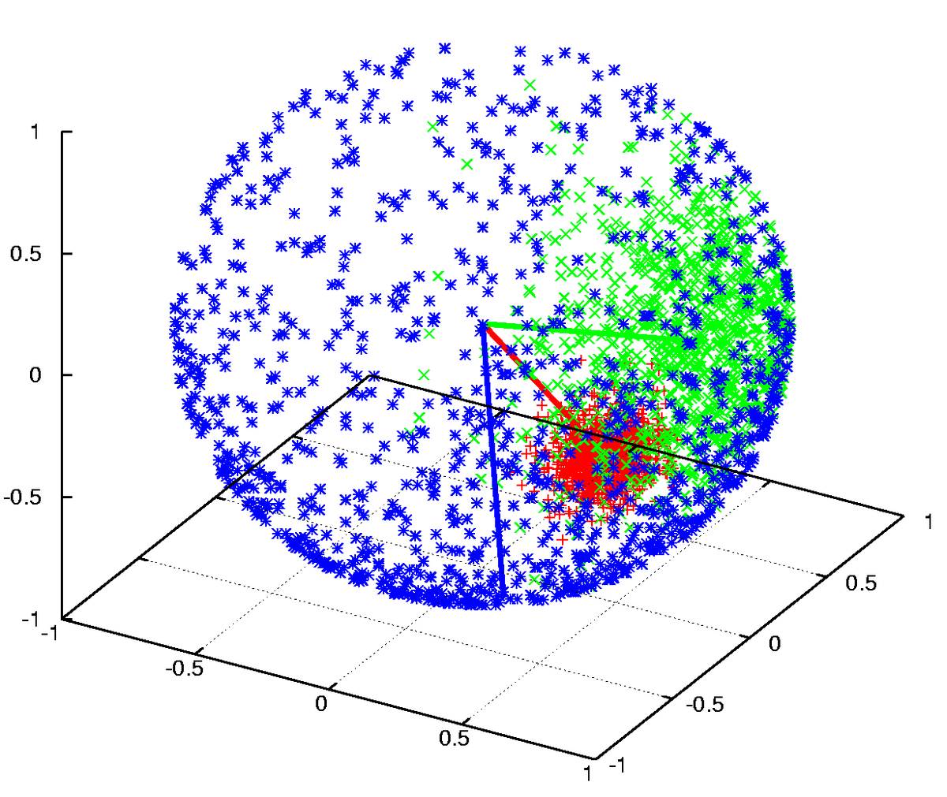
Taxonomy Generation from Massive Text Corpora
Automated construction of topic taxonomy
Selected method: spherical clustering—Use embeddings to find semantically consistent clusters
Domain-specific terms can be clustered together
“machine learning”, “learning algorithm”, ...
Where do the general terms go?
“computer science”, “method”, “paper”, …
Documents
Topic Dimension
“computer science”
“graphics”
“machine learning”

Slide 22
TaxoGen [KDD’18]: Adaptive Spherical Clustering
Design a ranking module to select representative phrases for each cluster
Conduct comparative analysis (combining popularity and concentration)
Does this phrase better fit my cluster or my sliblings‘?
Push the background phrases back to the general node
“computer science”, “paper” → the higher-level node (root node)
“machine learning”, “ml”, “classification“ → the “ML” node
The set of remaining phrases leads to more separable clustering

Slide 23
TaxoGen: Local Embedding vs. Global Embedding
Global embedding (embedding learning on the global dataset) does not work
Terms at different granularity can have close embeddings
Ex. “Information Extraction”: similar to “text mining”, “NLP”, “machine learning”
Solution: local-corpus embedding:
For each “sub-topic” node, learn local embedding only on relevant documents
Only perserve information relevant to the “sub-topic”

Slide 24
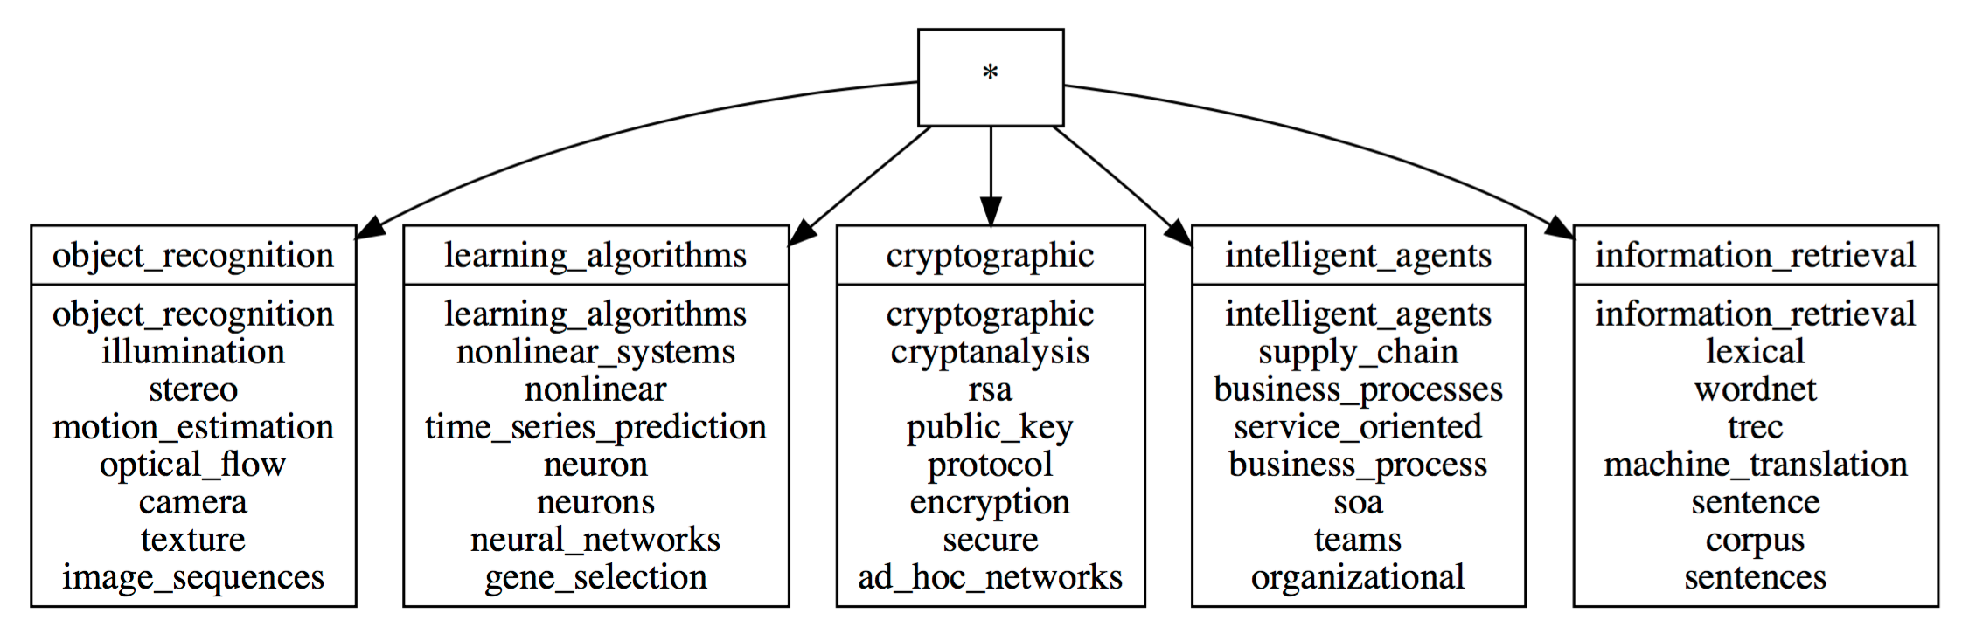
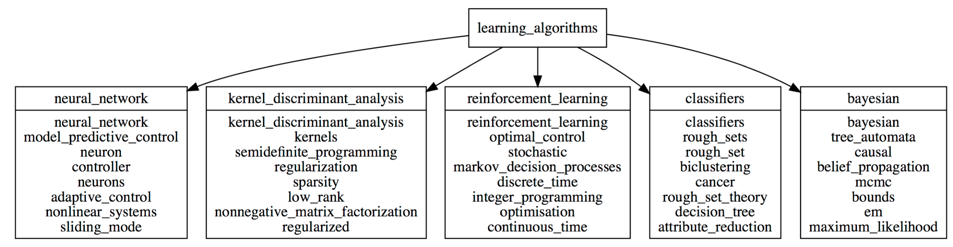
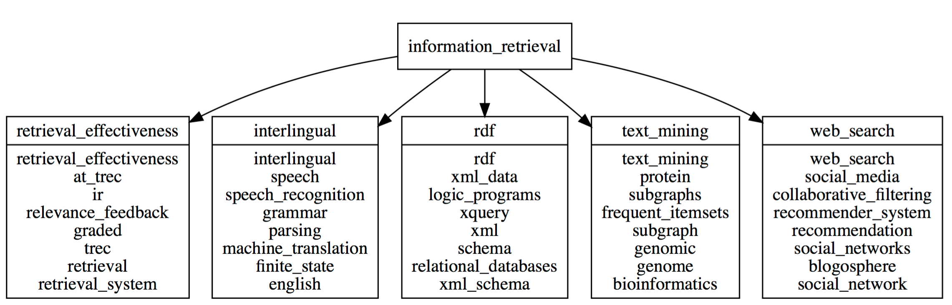
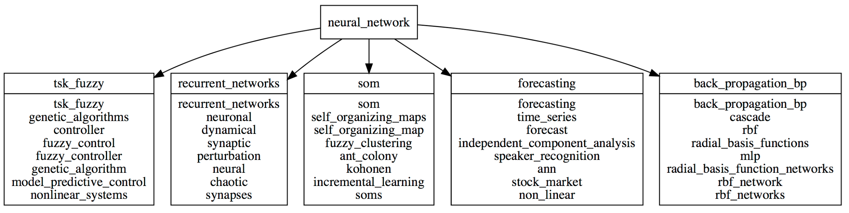
TaxonGen: Adaptive Spherical Clustering + Local Embedding
Phrase mining + Adaptive spherical clustering: Generate top-level clusters
Local embedding: Generate lower level clusters
Experiment with the DBLP dataset
High quality multi-level hierarchy generated automatically

Slide 25
Outline
On the Power of Multi-Dimensional Text Cubes
Automated Mining of Semantic Structures from Massive Text Data
Phrase Mining
Entity/Relation Recognition and Typing
Meta Pattern-Directed Structure Discovery
Automated Construction of Multidimensional Text Cubes
Multifaceted Taxonomy Mining
Doc2Cube: Constructing TextCube from Massive Documents
Quality Enhancement: Local and Global Joint Spherical Text Embedding
Looking Forward

Slide 26
Cube Construction: Which Document Goes to Which Cell?
Cell-based Document Allocation
Which document goes to which cell?
Corpus
Sports
USA
ID | Document Content
1 | … The super bowl is on air from Chicago, Illinois. The NFL has decided that best coach of 2017 is from…
2 | … make a speech in Shanghai that economy plan is to make sure manufactory industry of China…
3 | … in Dec 2015, attacks continued in France for two more days, taking the lives of six others
Politics
China
Dimensions
Documents
China
Economy
Russia
USA
Japan
Economy
Topic Dimension
2015
2016
2017
Location Dimension
Sports
Politics
Time Dimension
2014
Text Cube
2015
2016
Doc2Cube: Constructing Cube from Massive Docs: ICDM’18

Slide 27
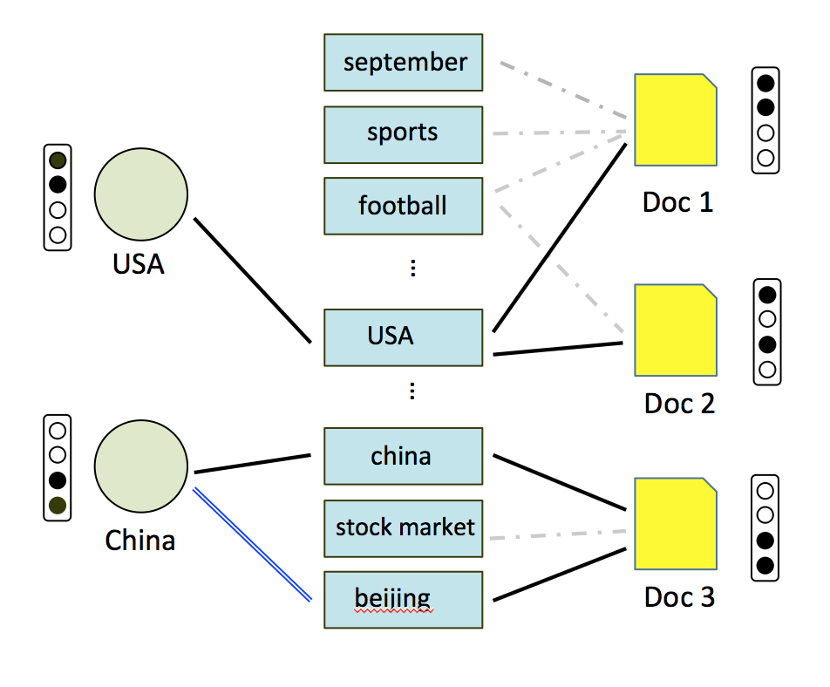
How to Put Documents into the Right Cube Cell?
Major challenges on putting docs into the right cell
Few would like label the “training sets”
So many cells, so many documents
Dimension values are often “under-represented”
E.g., Topic dimension: Sports, economy, politics, ….
Documents are often “over-represented” on single dimension
Ex. “ … … The super bowl is on air from Chicago, Illinois. The NFL has decided that best coach of 2017 is from …
Our methodology: Dimension-aware joint embedding
Constructing an L-T-D (label-term-document) graph
Politics
Economy
Sports
Labeled docs

Slide 28
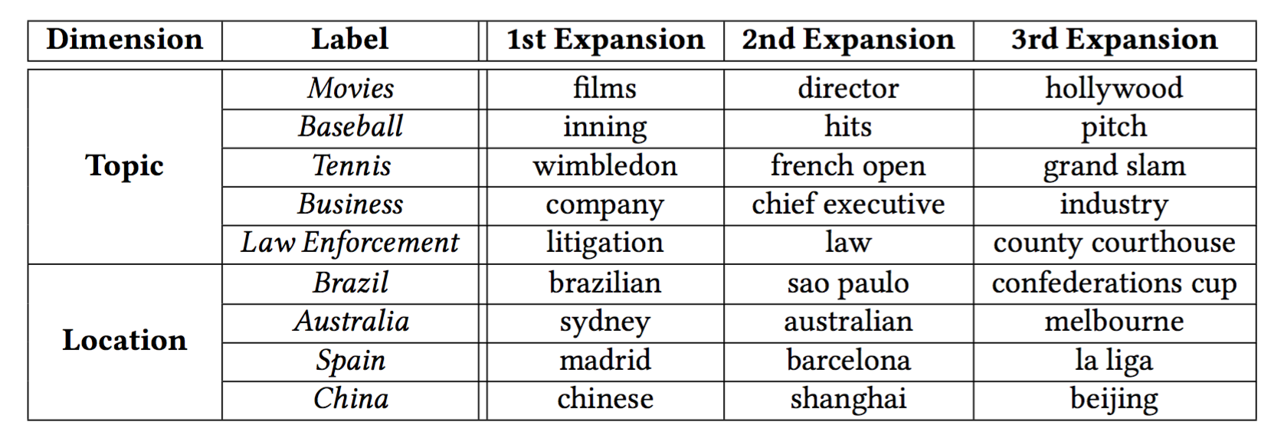
Constructing Text Cubes with Massive Data, Few Labels
Dimension focusing—Dimension-Focal Score, a discriminative measure
A term t is “focal” to dimension L
The documents with t has very imbalanced labels (KL-divergence can be a good measure)
Ex.
Label expansion: Combining two measures for seed expansion
Discriminativeness
Using focal score
Popularity
Example:

Slide 29
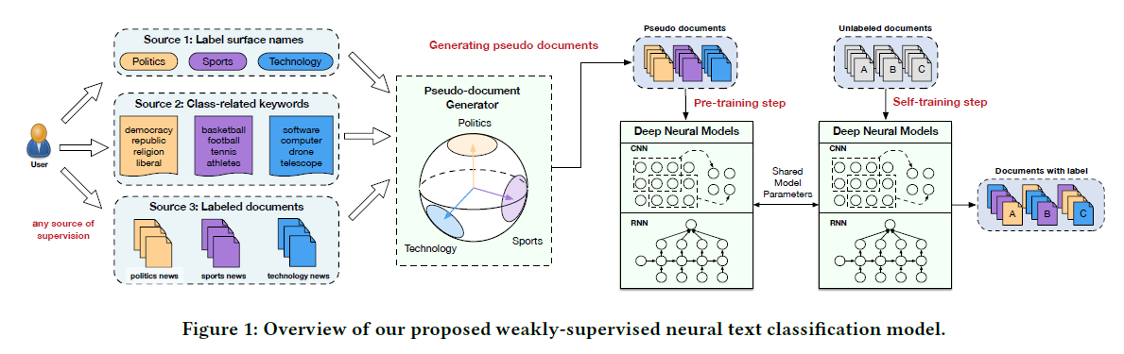
WeSTClass: Weakly Supervised Text Classification
Modeling class distribution in word2vec embedding space
Word2vec embedding captures skip-gram (local) similarity (i.e., words with similar local context windows are expected to have similar meanings)
WeSTClass (Weakly Supervised Text Classification): CIKM’18
WeSHClass (Weakly Supervised Hierarchical Text Classification): AAAI’19

Slide 30
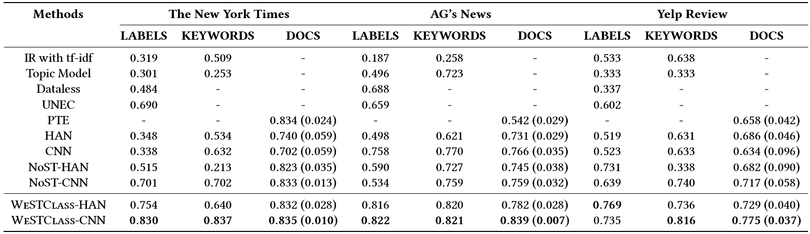
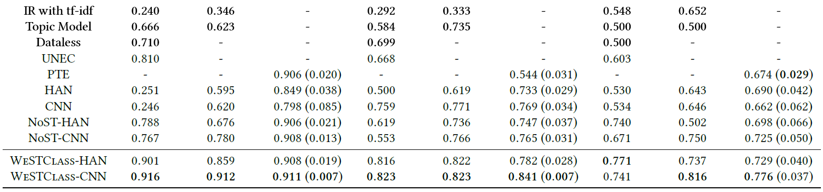
WeSTClass: Overall Classification Performance
Datasets: (1) NYT, (2) AG’s News, (3) Yelp
Evaluation: use different types of weak supervision and measure accuracies
Macro-F1 scores:
Micro-F1 scores:
Notes:
When labeled documents are given as the supervision source, the standard deviation values of WSTC-CNN and WSTC-HAN are smaller than those of CNN and HAN, respectively. This shows that WSTC can effectively reduce the seed sensitivity and improve the robustness of CNN and HAN models.
When the supervision source is label surface name or class-related keywords, we can see that WSTC-CNN and WSTC-HAN outperform CNN and HAN, respectively. This demonstrates that pre-training with generated pseudo documents results in a better neural model initialization compared to pre-training with documents that are labeled using either IR with tf-idf or Topic Modeling.
WSTC-CNN and WSTC-HAN always outperform NoST-CNN and NoST-HAN, respectively. Note that the only difference between WSTC-CNN/WSTC-HAN and NoST-CNN/NoST-HAN is that the latter two do not include the self-training module. The performance gaps between them thus clearly demonstrate the effectiveness of our self-training module.

Slide 31
Outline
On the Power of Multi-Dimensional Text Cubes
Automated Mining of Semantic Structures from Massive Text Data
Phrase Mining
Entity/Relation Recognition and Typing
Meta Pattern-Directed Structure Discovery
Automated Construction of Multidimensional Text Cubes
Multifaceted Taxonomy Mining
Doc2Cube: Constructing TextCube from Massive Documents
Quality Enhancement: Local and Global Joint Spherical Text Embedding
Looking Forward

Slide 32
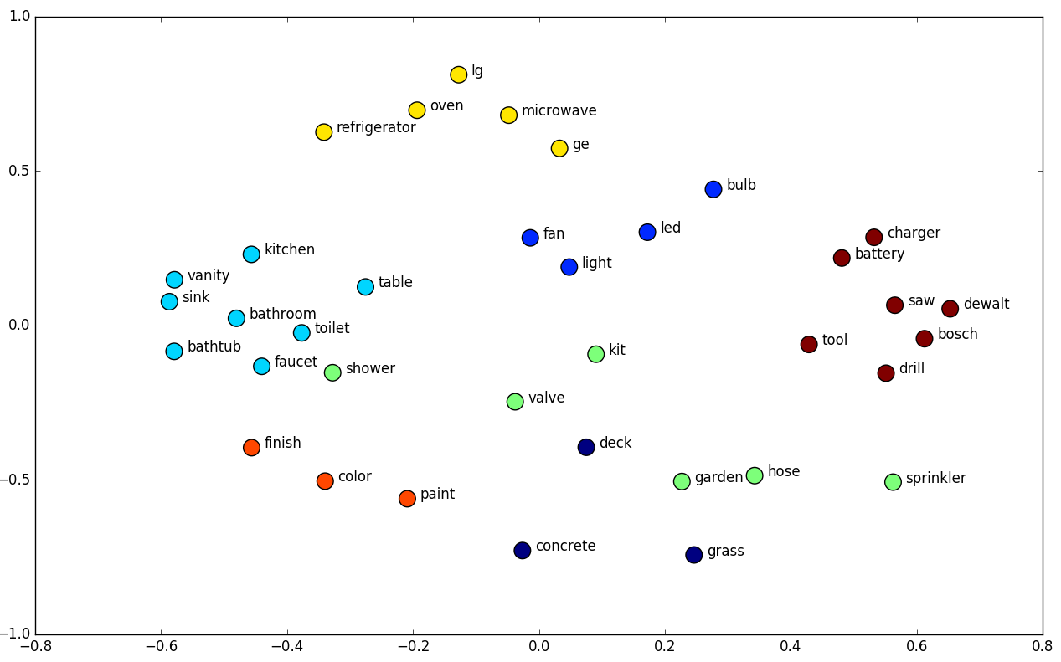

Text Embedding: Preliminaries
A milestone in NLP and ML: Unsupervised learning of text representations
Embed one-hot vectors into lower-dimens. space—Address “curse of dimensionality”
Word embedding captures useful properties of word semantics
Word similarity: Words with similar meanings are embedded closer
Word analogy: Linear relationships between words (e.g., king − queen = man−woman)
Word Analogy
Word Similarity
Typical embedding methods:
Word2Vec
GloVe
fastText
Trained in Euclidean space

Slide 33
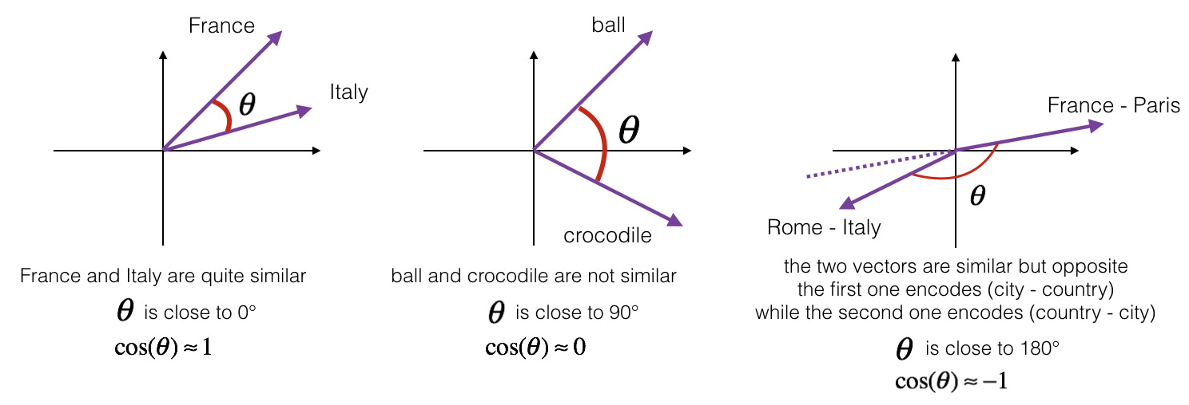
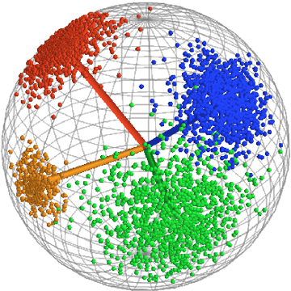
Why Spherical Text Embedding? [NeurIPS’19]
Previous text embeddings (e.g., Word2Vec) are trained in the Euclidean space
But used on spherical space—Mostly directional similarity (i.e., cosine similarity)
Word similarity is derived using cosine similarity
Word clustering (e.g., TaxoGen) is performed on a sphere
Better document clustering performances when embeddings are normalized and spherical clustering algorithms are used

Slide 34
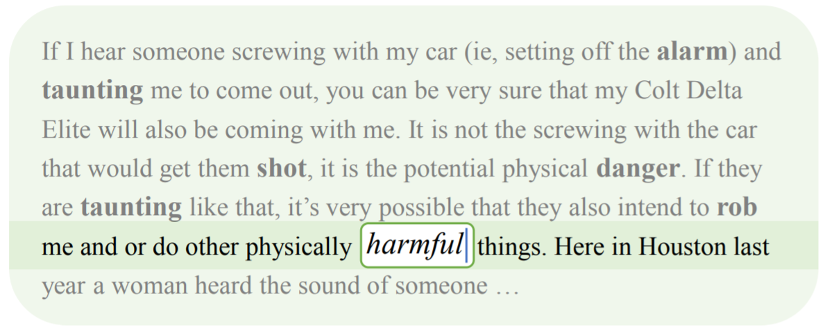
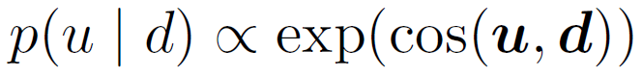
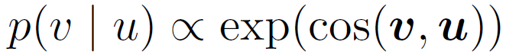
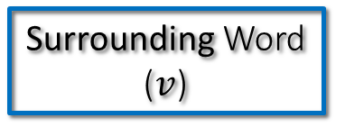
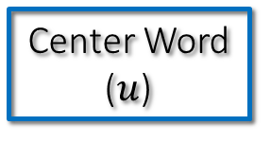
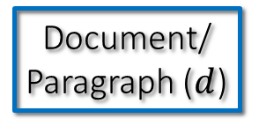
Why Integrating Local and Global Contexts?
Local contexts can only partly define word semantics in unsupervised word embedding learning
Design a generative model on the sphere that follows how humans write articles:
First a general idea of the paragraph/doc, then start to write down each word in consistent with not only the paragraph/doc, but also the surrounding words
Local contexts of “harmful”
Document/
Paragraph ($d$)
Center Word ($u$)
Surrounding Word ($v$)

Slide 35
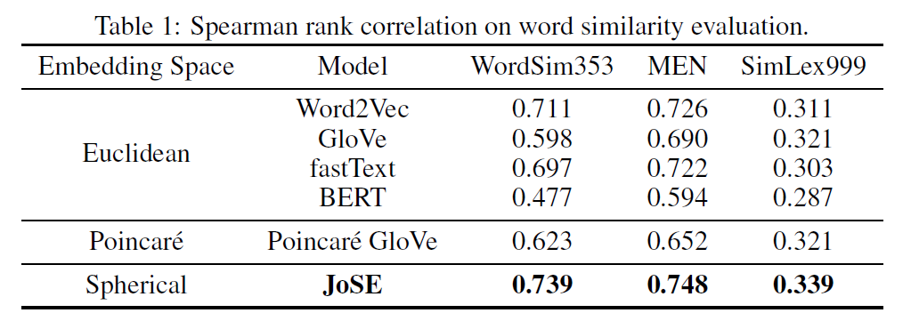
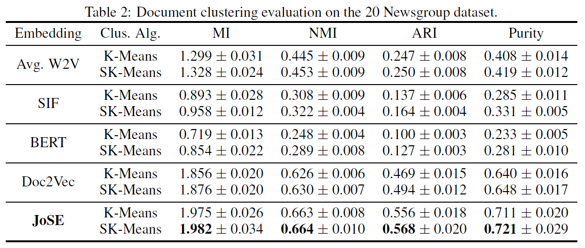
JoSE: Performance Comparison with Recent Methods
JoSE: Joint Spherical Text Embedding [NeurIPS’19]
Word similarity results:
Document clustering results:

Slide 36
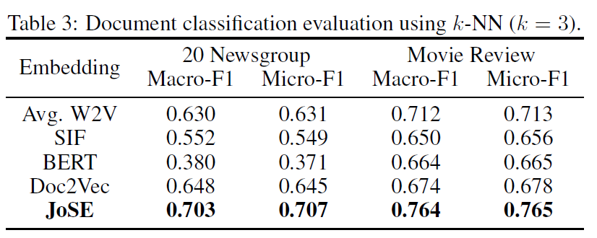
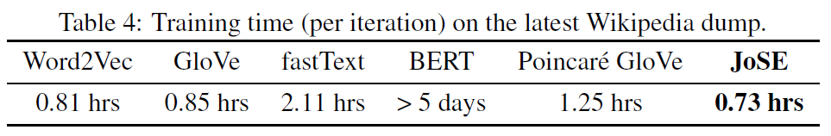
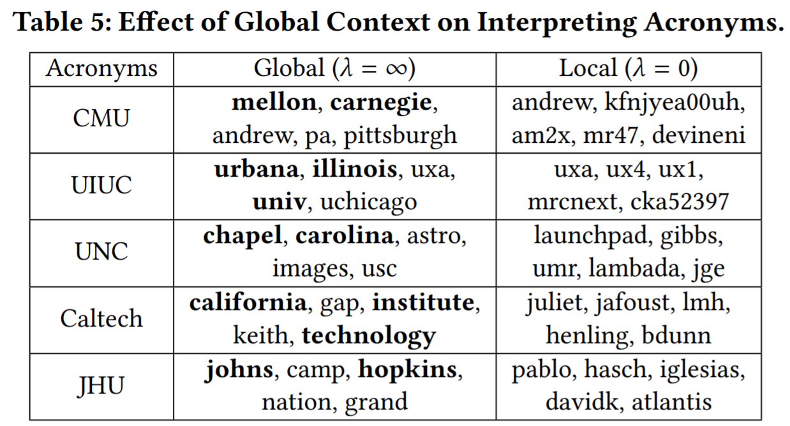
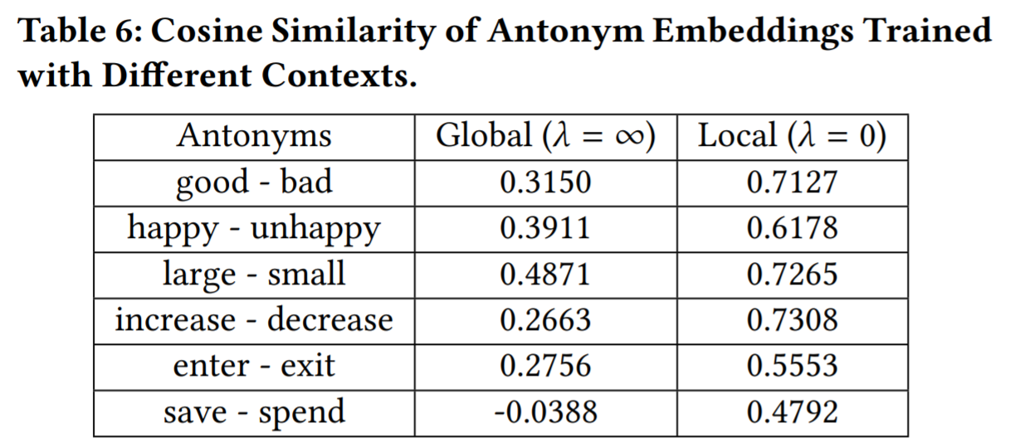
JoSE: Performance & Case Studies
Document classification results
Training efficiency
Acronym → similar words
Testing antonym similarity

Slide 37
Outline
On the Power of Multi-Dimensional Text Cubes
Automated Mining of Semantic Structures from Massive Text Data
Phrase Mining
Entity/Relation Recognition and Typing
Meta Pattern-Directed Structure Discovery
Automated Construction of Multidimensional Text Cubes
Multifaceted Taxonomy Mining
Doc2Cube: Constructing TextCube from Massive Documents
Quality Enhancement: Local and Global Joint Spherical Text Embedding
Looking Forward

Slide 38
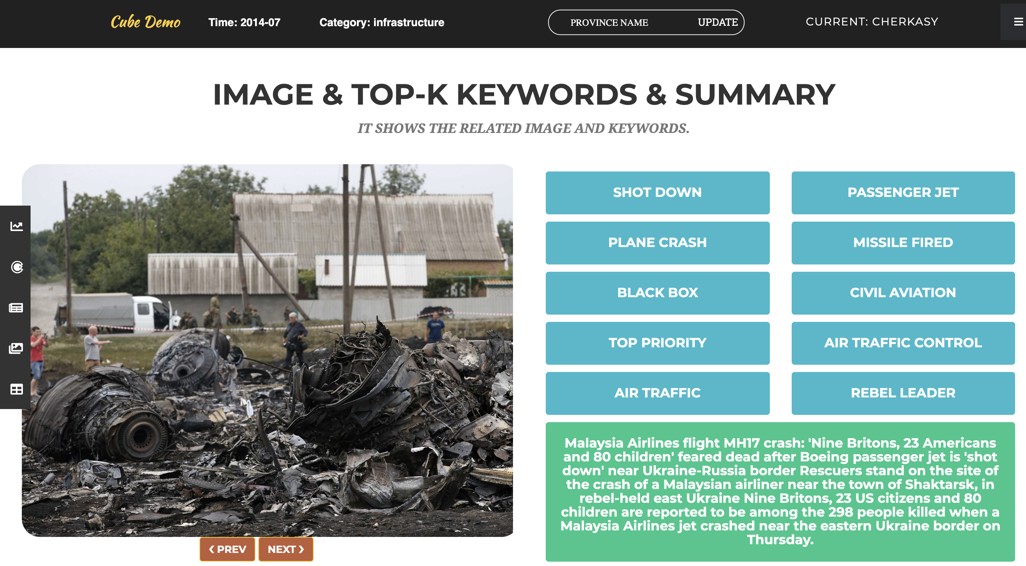
Application: Support Multi-Dimensional Text Analysis
Ukraine-Russia Conflicts: MH17 Shot-Down
Notes:
Use caseolap to capture top-10 representative phrases for the cell of 2014-07, Cherkasy and the topic of infrastructure.
Keyphrase results: …
We also extract sentences that cover most of the keywords as summarization for the cell.
News images are collected from documents belonging to this cell, and they depict the scene of the plane crash.

Slide 39
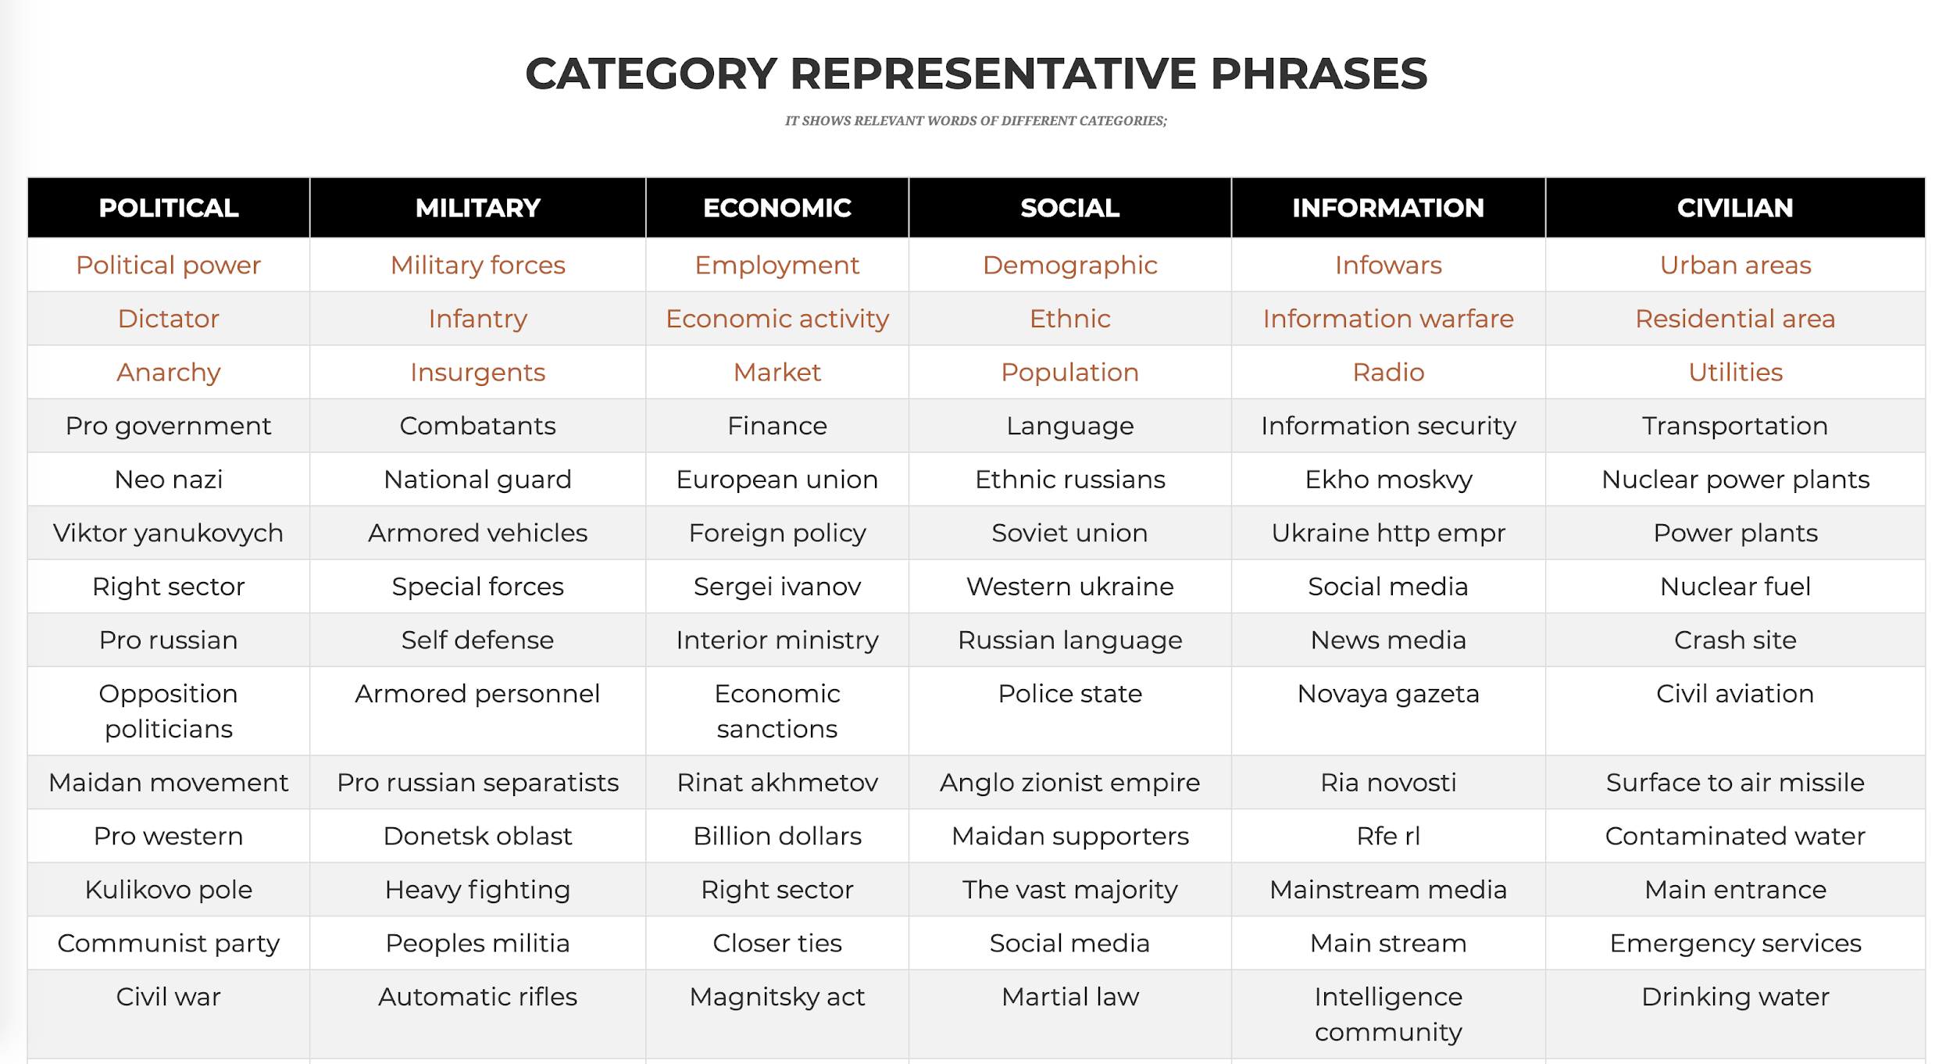
Analysis of Russia-Ukraine Conflicts
category names and three examples from the experts
Category representative phrases generated automatically
Notes:
Category representative phrases are generated automatically using the embedding training algorithm CatE introduced in section 2. Briefly, we train the embedding for each topic using three keywords from experts as weak supervision. For example, we have … as keywords for topic political, then we can regularize the semantic space and found words under the topic of political, such as ….

Slide 40
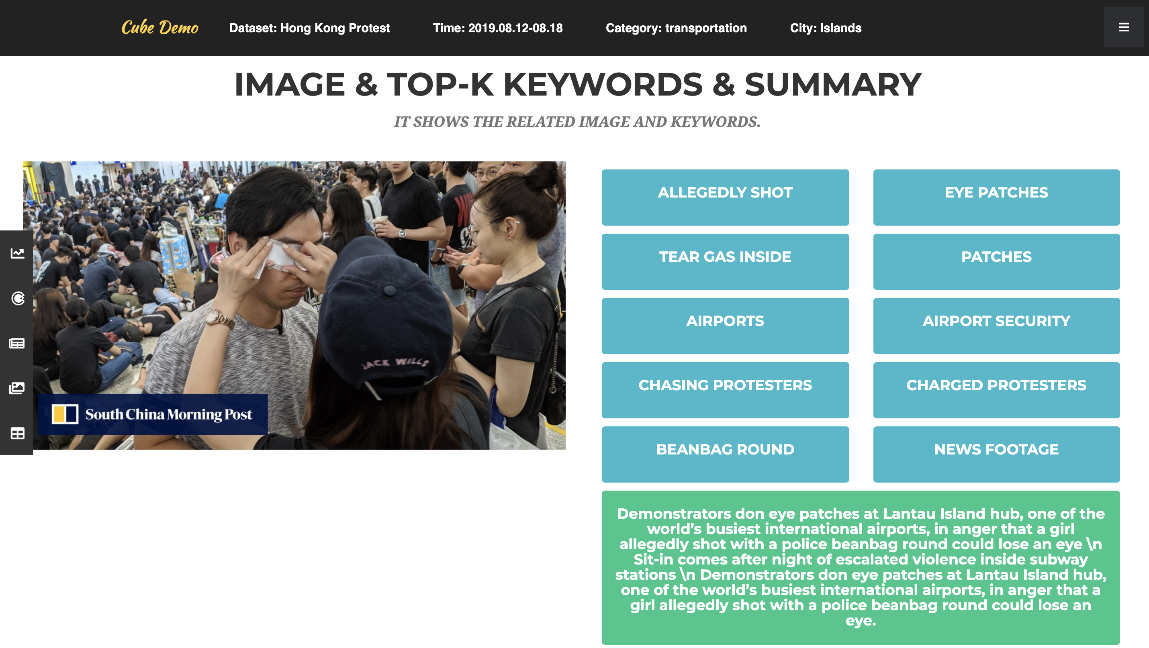
MissionCube: Analysis of Different News Data Sets: HK Protests

Slide 41
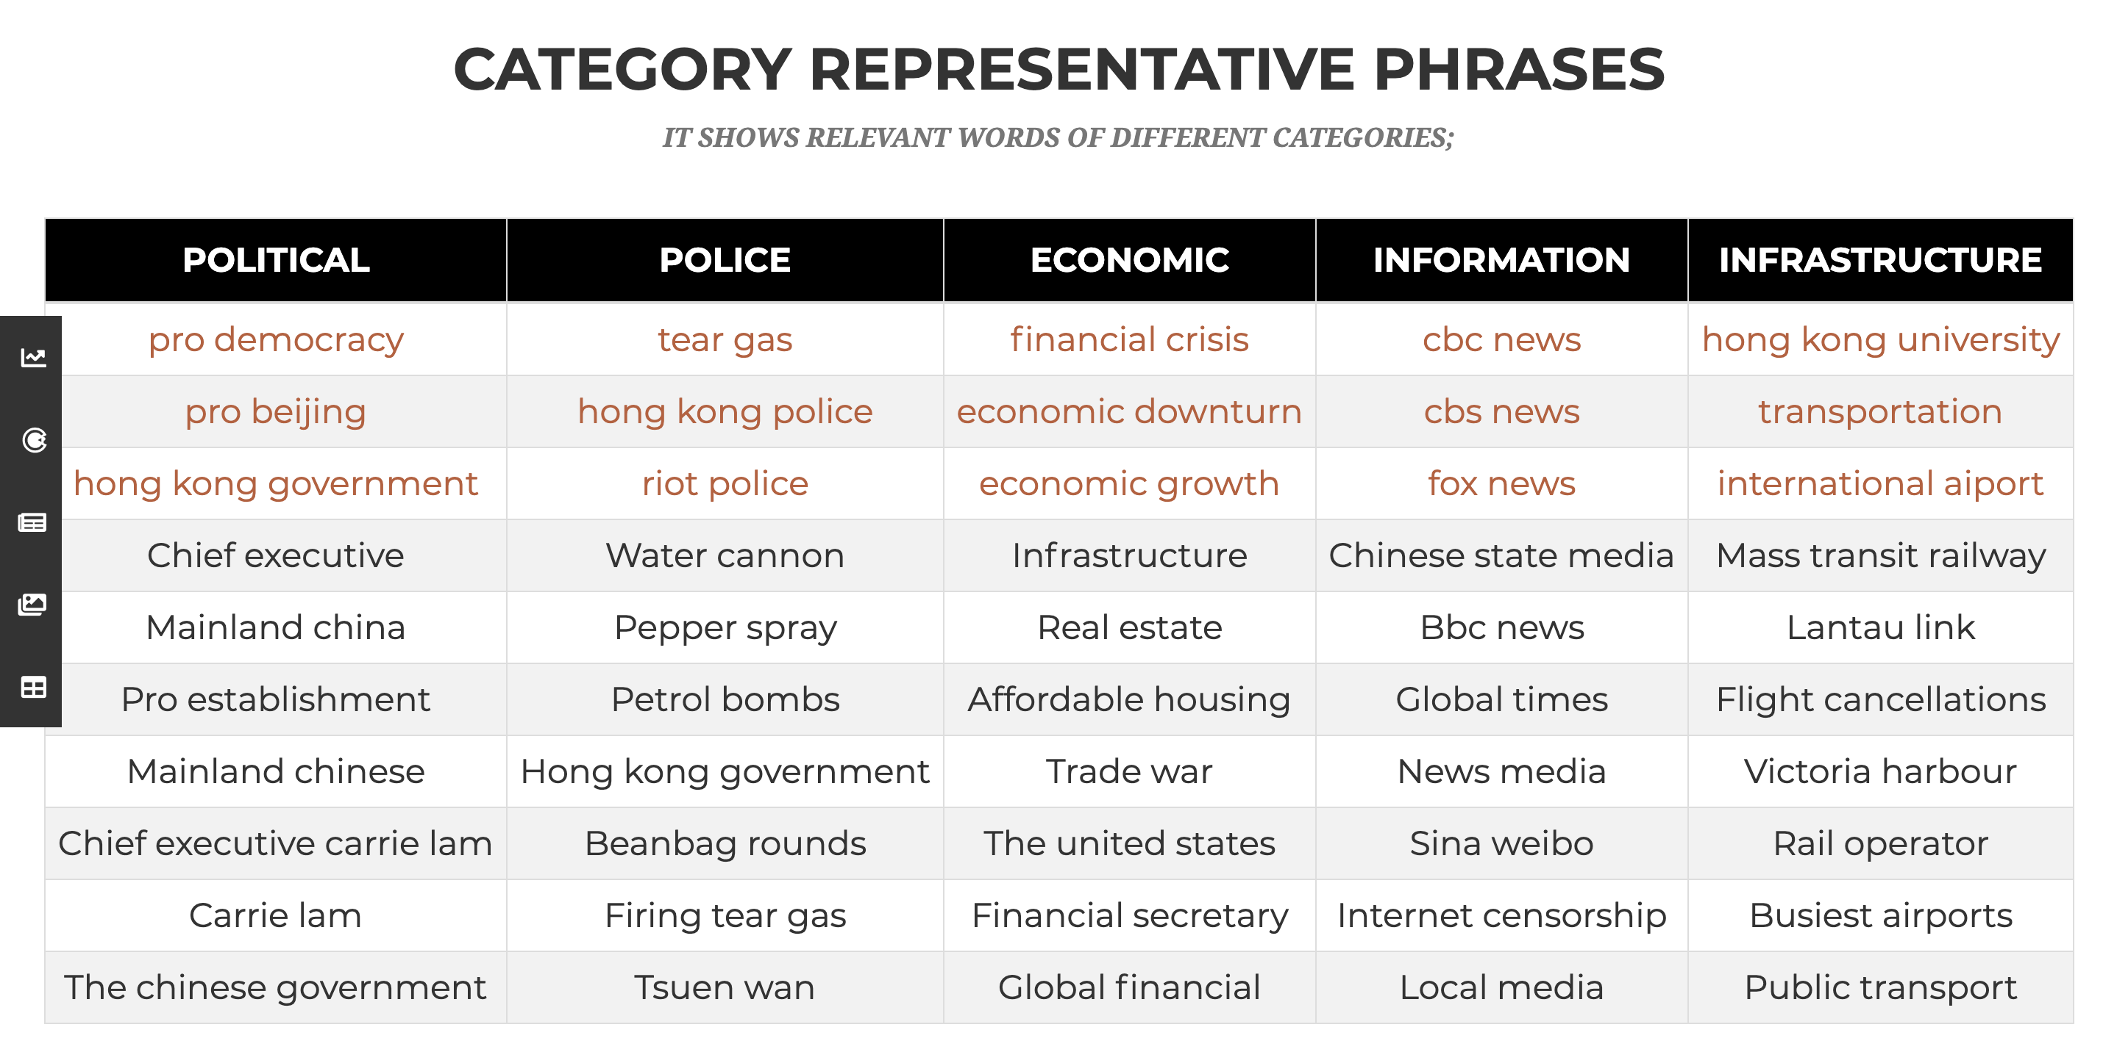
Analysis of Hong Kong Protests
Category representative phrases generated automatically
category names and three examples from the experts

Slide 42
Looking Forward: Structural Mining of Massive Text Data
From big data to big knowledge
A key problem: Structural mining of massive text data
Lots to be explored!!!
Heterog. networks
Text Corpus
Phrases
Knowledge
General KB
Typed entities
Multi-dimensional Cubes

Slide 43






Our Journey: From Big Data to Big Structures & Knowledge
C. Zhang: SIGKDD’19 Dissertation Award Runner-Up
Xiang Ren: SIGKDD’18 Dissertation Award
Han, Kamber and Pei,
Data Mining, 3rd ed. 2011
Yu, Han and Faloutsos (eds.),
Link Mining, 2010
Sun and Han, Mining Heterogeneous
Information Networks, 2012
Y. Sun: SIGKDD’13 Dissertation Award
Wang and Han, Mining Latent Entity Structures, 2015
C. Wang: SIGKDD’15 Dissertation Award

Slide 44
References
M. Jiang, J. Shang, X. Ren, T. Cassidy, L. Kaplan, T. Hanratty and J. Han, “MetaPAD: Meta Pattern-driven Attribute Discovery from Massive Text Corpora”, KDD’17
Q. Li, M. Jiang, X. Zhang, M. Qu, T. Hanratty, J. Gao and J. Han, “TruePIE: Discovering Reliable Patterns in Pattern-Based Information Extraction”, KDD’18
J. Liu, J. Shang, J. Han, Phrase Mining from Massive Text and Its Applications, M. & Claypool, 2017
Y. Meng, J. Huang, G. Wang, C. Zhang, H. Zhuang, L. Kaplan and J. Han, "Spherical Text Embedding", NeurIPS’19
Y. Meng, J. Shen, C. Zhang and J. Han, "Weakly-Supervised Neural Text Classification", CIKM’18
X. Ren, A. El-Kishky, C. Wang, F. Tao, C. R. Voss, H. Ji and J. Han, “ClusType: Effective Entity Recognition and Typing by Relation Phrase-Based Clustering”, KDD’15
X. Ren and J. Han, Mining Structures of Factual Knowledge from Text: An Effort-Light Approach, Morgan & Claypool, 2018
F. Tao, C. Zhang, X. Chen, M. Jiang, T. Hanratty, L. Kaplan, J. Han, “Doc2Cube: Automated Document Allocation to Text Cube via Dimension-Aware Joint Embedding”, ICDM’18
C. Zhang, F. Tao, X. Chen, J. Shen, M. Jiang, B. Sadler, M. Vanni and J. Han, “TaxoGen: Constructing Topical Concept Taxonomy by Adaptive Term Embedding and Clustering”, KDD’18

